Slide 1
The human eye and colourful world part 3 : Refraction of light through prism dispersion of light and Scattering of light
Chapter 11
Notes:
Welcome to the third part of chapter 11
Topic that we will cover is :
Refraction of light through prism
dispersion of light
Scattering of light

Slide 2
REFRACTION OF LIGHT THROUGH A PRISM
Refraction
Notes:
Before getting into refraction by prim lets understand what is refraction
By formal definition refraction can be:
the bending of a wave when it enters a medium where its speed is different. The refraction of light when it passes from a fast medium to a slow medium bends the light ray toward the normal to the boundary between the two media

Slide 3
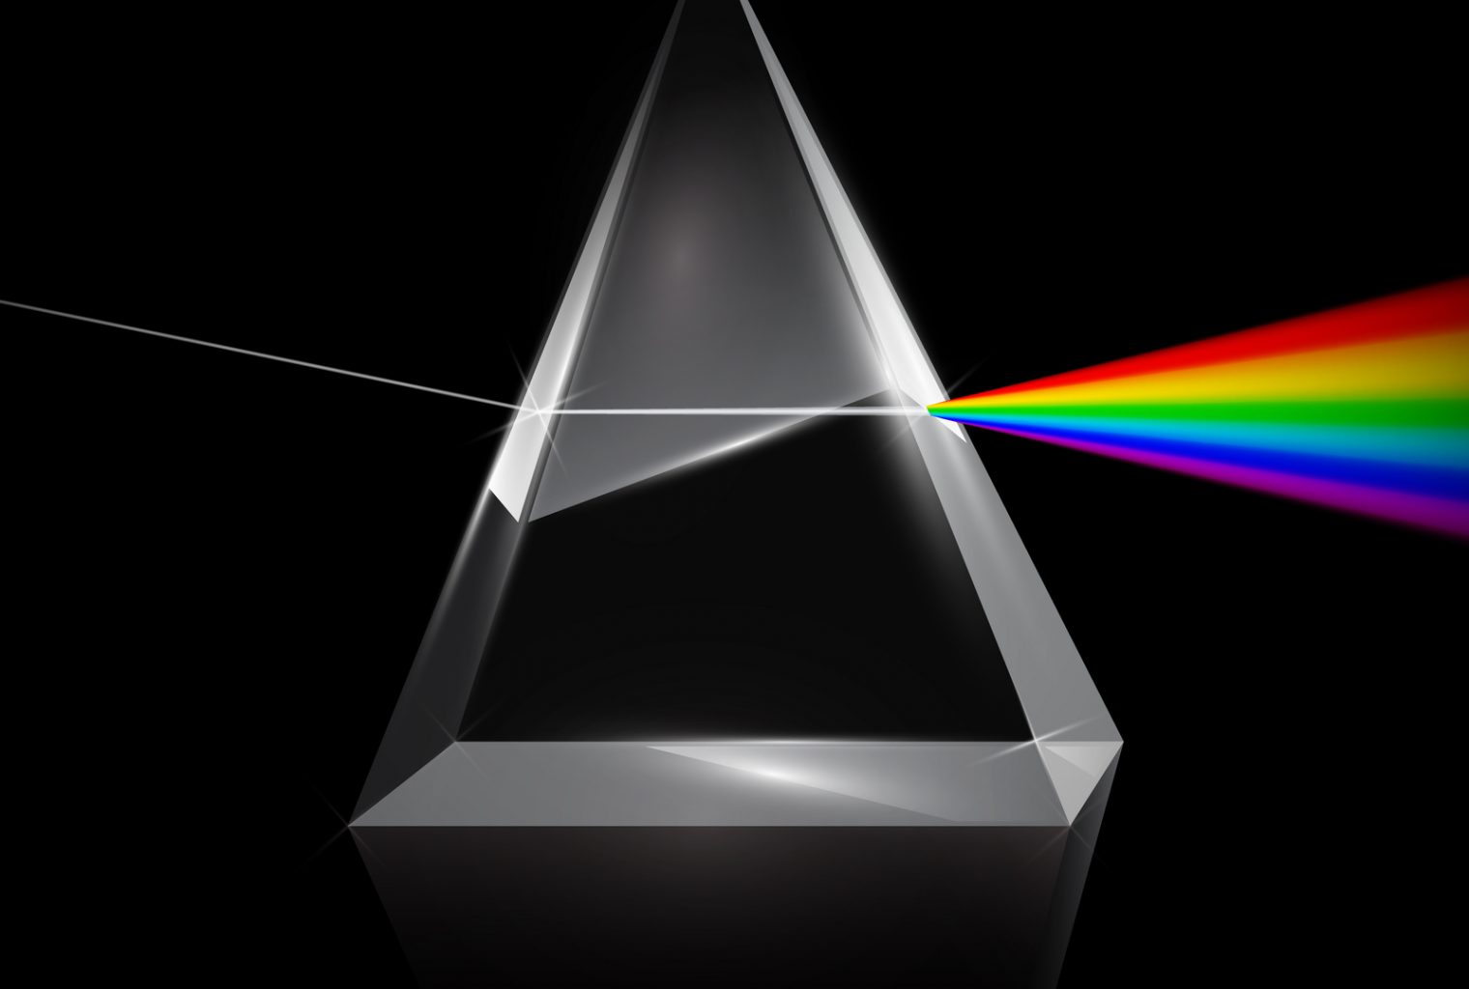
REFRACTION OF LIGHT THROUGH A PRISM
WHAT IS A PRISM ?
Notes:
It has two triangular bases and three rectangular lateral surfaces. These surfaces are inclined to each other. The angle between its two lateral faces is called the angle of the prism
When a ray of light enters the glass prism it gets deviated two times. First when it enters the glass prism and next when it comes out of the prism. This is because the refracting surfaces of the prism are not parallel to each other.
Also it is important to notice that, when the ray of light passes through the prism it bends towards its base.

Slide 4
SCATTERING OF LIGHT
The effect of scattering of light in nature:
The blue colour of the sky,
Colour of water in deep sea,
The reddening of the sun at sunrise and the sunset
Notes:
The effect of scattering of light in nature:
The blue colour of the sky,
colour of water in deep sea,
the reddening of the sun at sunrise and the sunset

Slide 5
RAINBOW
Notes:
A rainbow is a natural spectrum appearing in the sky after a rain shower It is caused by dispersion of sunlight by tiny water droplets, present in the atmosphere. A rainbow is always formed in a direction opposite to that of the Sun. The water droplets act like small prisms

Slide 6
ATMOSPHERIC REFRACTION
Flickering of objects seen through a turbulent stream of hot air rising above a fire or a radiator
Notes:
might have observed the apparent random wavering or flickering of objects seen through a turbulent stream of hot air rising above a fire or a radiator. The air just above the fire becomes hotter than the air further up. The hotter air is lighter (less dense) than the cooler air above it, and has a refractive index slightly less than that of the cooler air.

Slide 7
TWINKLING OF STARS
Notes:
Stars twinkle because of turbulence in the atmosphere of the Earth. As the atmosphere churns, the light from the star is refracted in different directions. This causes the star's image to change slightly in brightness and position

Slide 8
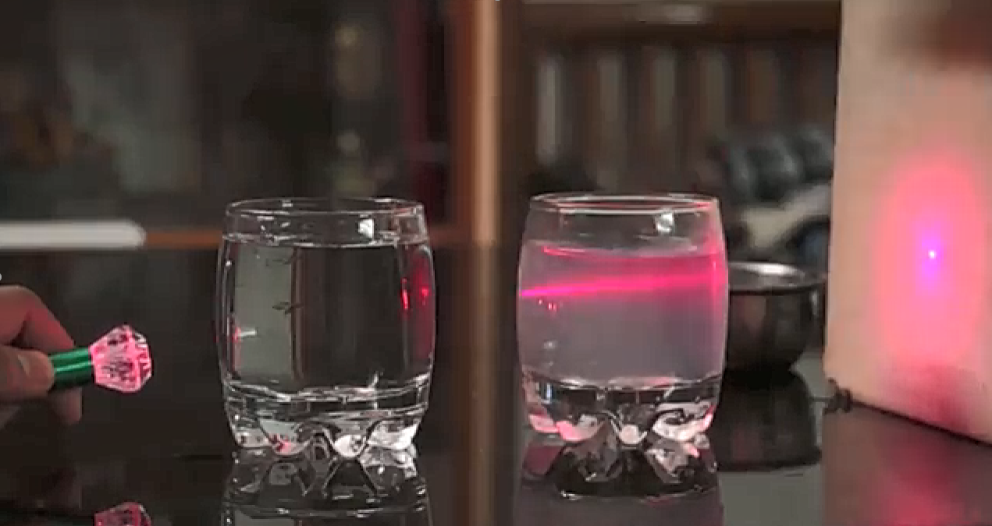
TYNDALL EFFECT
Notes:
The earth’s atmosphere is a heterogeneous mixture of minute particles. These particles include smoke, tiny water droplets, suspended particles of dust and molecules of air. When a beam of light strikes such fine particles, the path of the beam becomes visible. The light reaches us, after being reflected diffusely by these particles. The phenomenon of scattering of light by the colloidal particles gives rise to Tyndall effect
The colour of the scattered light depends on the size of the scattering particles. Very fine particles scatter mainly blue light while particles of larger size scatter light of longer wavelengths. If the size of the scattering particles is large enough, then, the scattered light may even appear white.

Slide 9
THANK YOU
Notes:
Thank you that is it for this lecture and the chapter.

